Slide 1
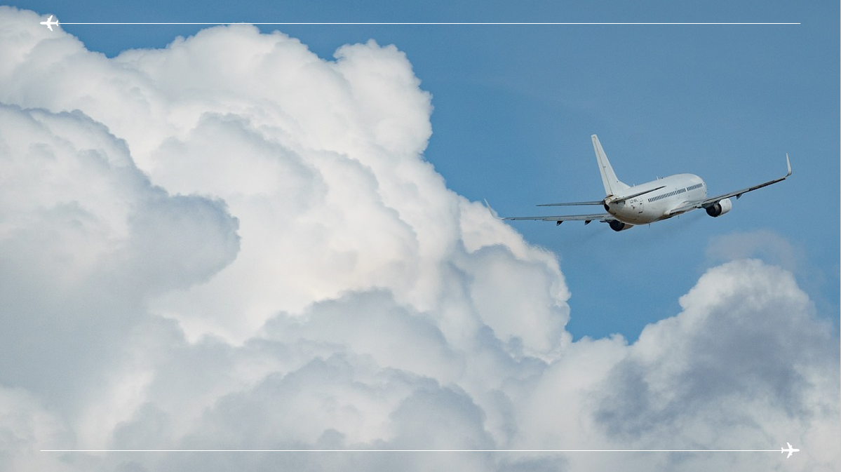
Big Data Method Group Project
Flight Delays Predictions

Slide 2

Big Data Method Group Project ALY6110 Professor: Anis Sharafoddini
Farhan Khaliq
Joumana Obeid
Aashish Punjabi
Siyan Shen
Thu Tran
July 1st , 2023

Slide 3
Executive Summary
The average departure delay is approximately 9.37.
The most common cancellation reasons across all airlines are "Weather," and "Airline/Carrier“.
The most common reasons for delays are :”Air System Delay” and “Airline Delay”
Even though Southwest Airlines (WN) recorded the most delays, its delays exceeding 45 minutes are 4 times less than delays between 5 and 45 minutes.
the analysis identified significant relationships between various factors (DISTANCE, AIRLINE ,ORIGIN_AIRPORT ,AIR_SYSTEM_DELAY ,SECURITY_DELAY, AIRLINE_DELAY ,LATE_AIRCRAFT_DELAY, WEATHER_DELAY) and (DEPARTURE_DELAY)

Slide 4
Business Problem
Air travel is essential for efficient transportation, but delays and cancellations create disruptions and financial consequences. Understanding causes, and effects is crucial. Our project analyzes the 2015 flight delay dataset to uncover insights, identify patterns, and develop accurate forecasts. The dataset includes departure times, airline info, delays, and distances, offering valuable information for analysis.
This presentation answers the following questions:
In the dataset, how are departure delays distributed?
What are the primary reasons for flight cancellations for each airline?
How do different airlines distribute cancellation reasons?
Predict/Forecast "DEPARTURE_DELAY”,based on the independent variables in the dataset.

Slide 5
Data set Overview
Kaggle Data Set -Flight Delays
YEAR, MONTH, DAY, DAY_OF_WEEK: dates of the flight
AIRLINE: An identification number assigned by US DOT to identify a unique airline
ORIGIN_AIRPORT and DESTINATION_AIRPORT: code attributed by IATA to identify the airports
SCHEDULED_DEPARTURE and SCHEDULED_ARRIVAL : scheduled times of take-off and landing
DEPARTURE_TIME and ARRIVAL_TIME: real times at which take-off and landing took place
DEPARTURE_DELAY and ARRIVAL_DELAY: difference (in minutes) between planned and real times
DISTANCE: distance (in miles)
Each entry of the flights.csv file corresponds to a flight, and we see that more than 5'800'000 flights have been recorded in 2015. These flights are described according to 31 variables. These are some of the meaningful variables ⁽¹⁾.

Slide 6
METHODOLOGY
Data Cleaning
Exploratory Data Analysis
Visualizations
Forecasting.

Slide 7
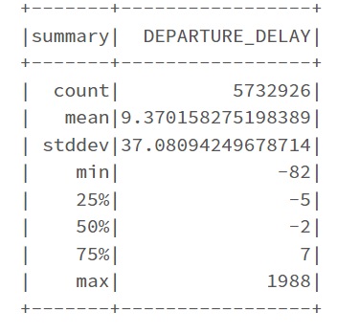
Data Cleaning and EDA
Data types matching.
Count: The total number is 5,732,926 delays.
Mean: The average departure delay is approximately 9.37. This indicates that, on average, flights tend to depart slightly later than their scheduled departure time.
Standard Deviation: The standard deviation of the departure delay is approximately 37.08. This measures the dispersion and indicates it is quite large.
figure1.Departure Delay Summary

Slide 8
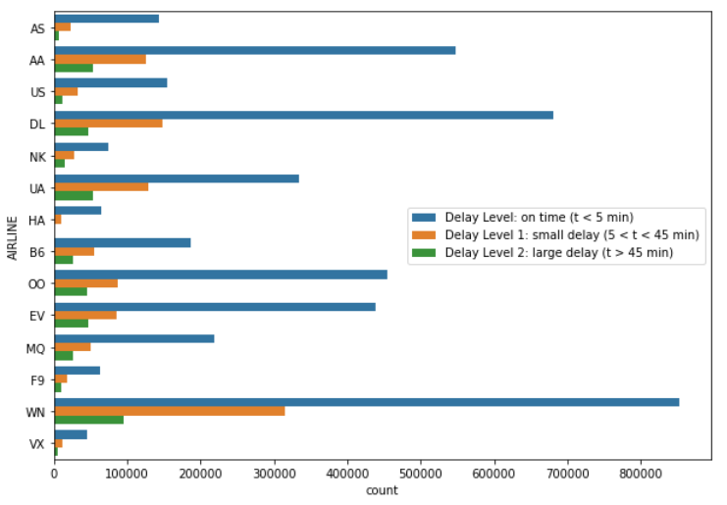
EDA-Continued
Distribution of Delay Per Airline
For instance, SkyWest(OO) Airlines has a 30% lower number of delays greater than 45 minutes than delays in the range of 5 to 45 minutes. On the other hand, Southwest (WN)Airlines delays exceeding 45 minutes are four times less frequent than delays of 5 to 45 minutes. This indicates a relatively better performance in minimizing long delays.
figure2.Distribution of Delay per Airline

Slide 9
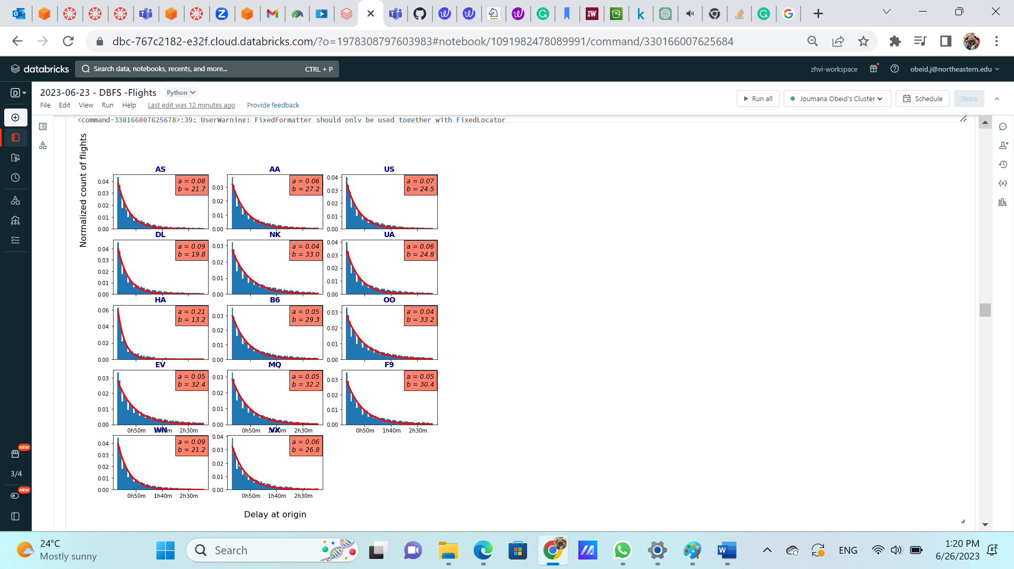
EDA -Continued
Distribution of The Ranking
This figure displays the normalized distribution of delays, modeled using an exponential distribution function f(x) = a * exp(-x/b)
Lower values of a indicate a higher proportion of significant delays, while higher values of a indicate airlines that prioritize punctuality.
JetBlue Airways Corporation(B6) and Frontier Flight(F9) recorder a higher proportion of significant delays.
figure3.Distribution of The Ranking

Slide 10
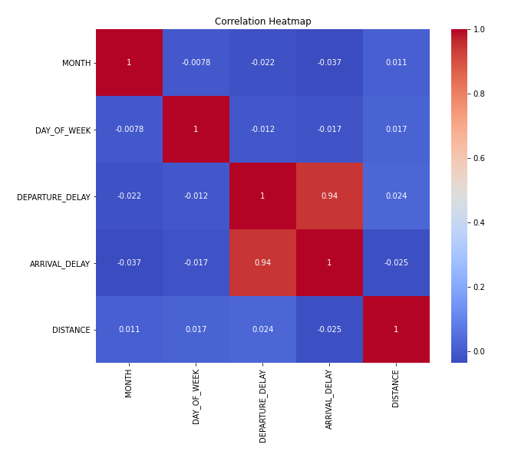
EDA-Continued
We see a weak negative correlation between distance and departure delays.
We see a weak negative correlation between the month and departure delays.
We see a weak negative correlation between day of the week and departure delays.
To understand better these correlations, we created distribution of these variables.
figure4.Relation Between Variables, Esp. Distance and Delay

Slide 11
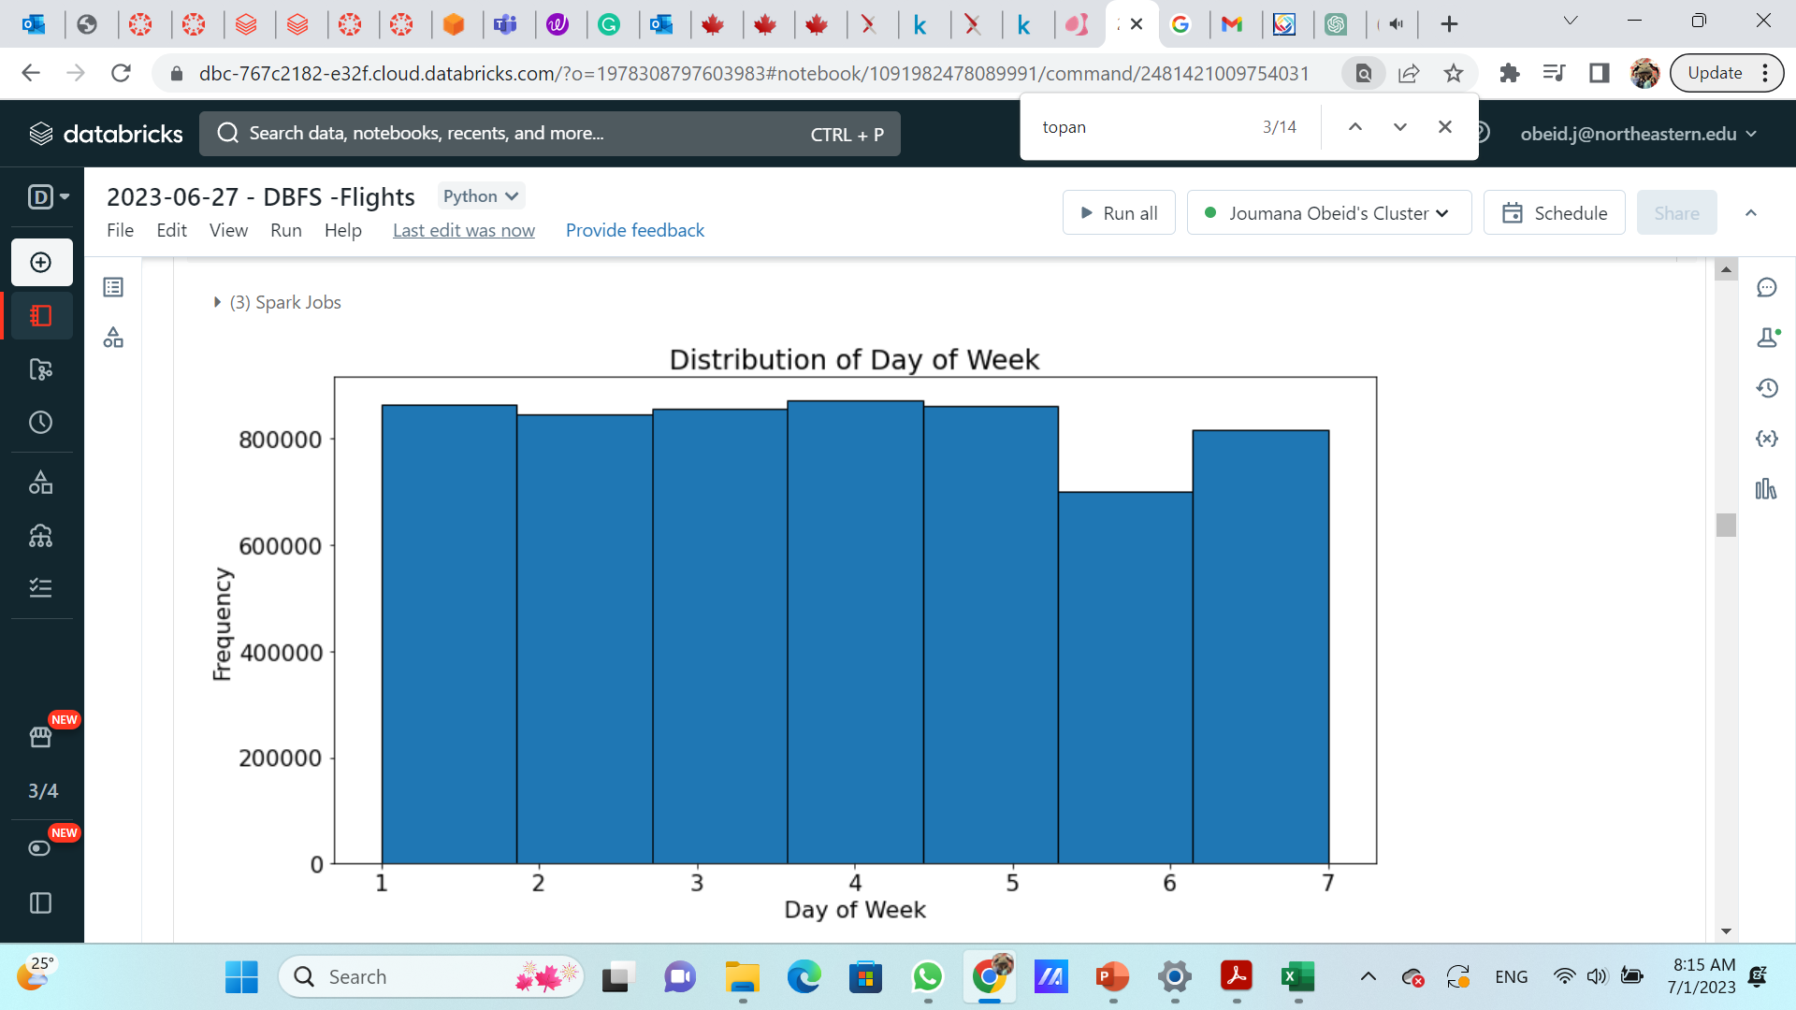
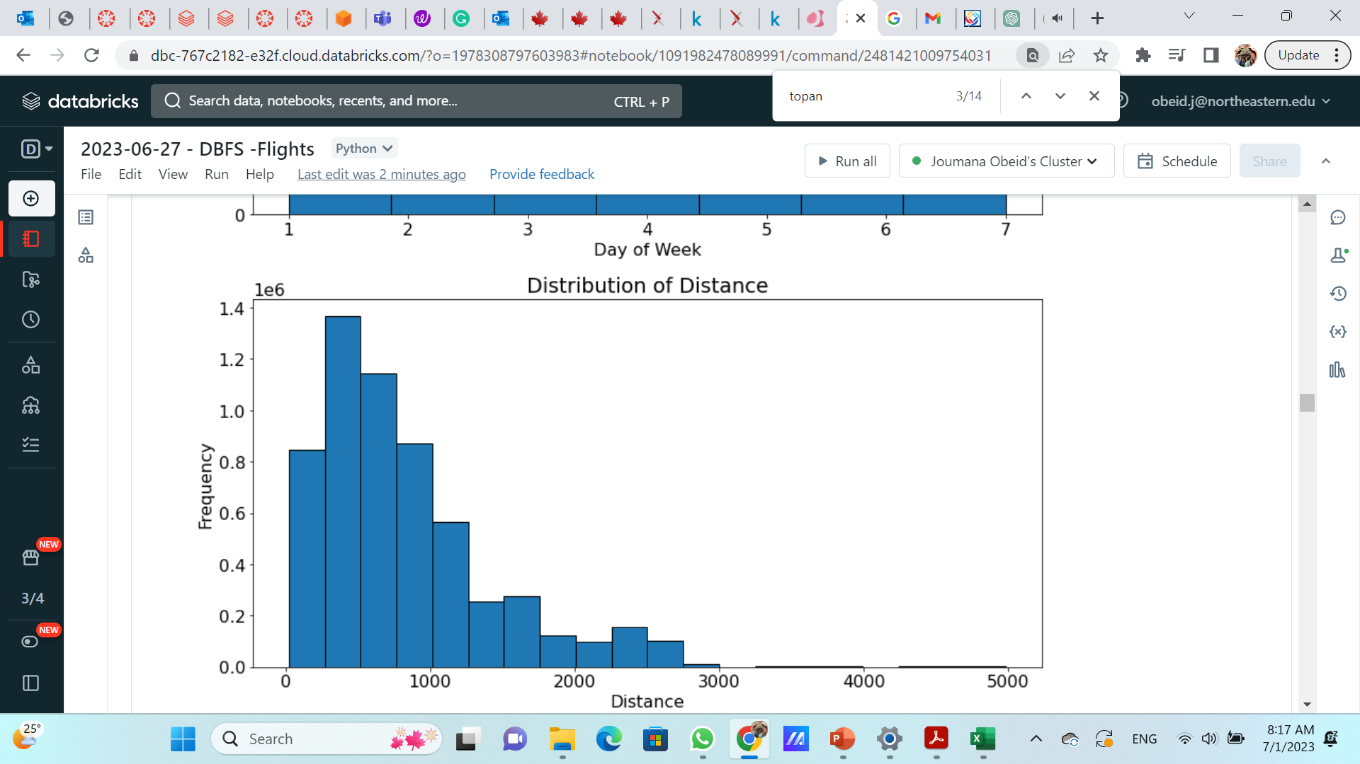
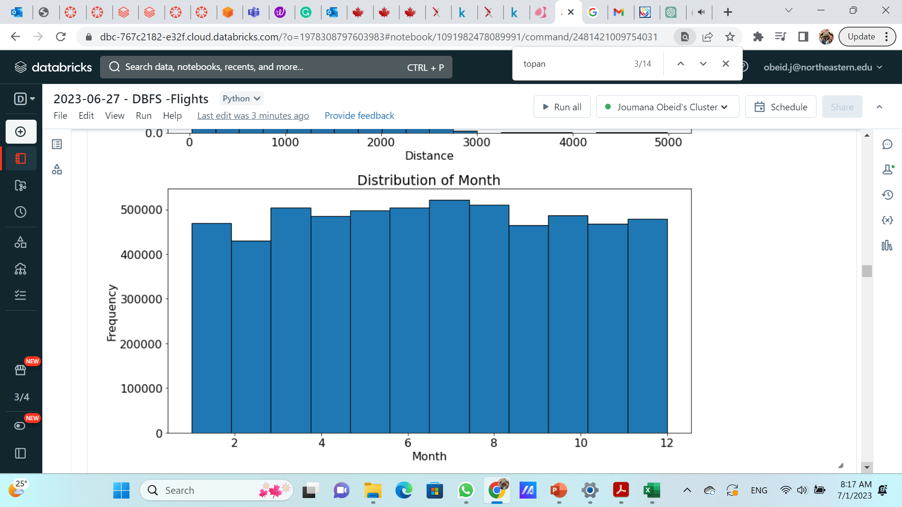
EDA-Continued
figure5.Distribution of Day of the week
figure6.Distribution of Day of Distance
We can see that most flights are for short distances.
This can be the cause for the weak correlations.
figure7.Distribution of Day of Month

Slide 12
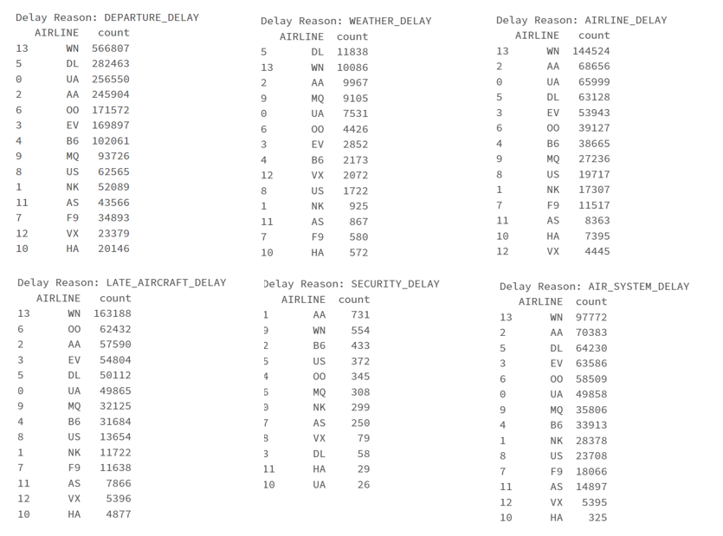
EDA- Continued
While Frontier Flight (F9) and JetBlue Airways both recorded high numbers of delays, JetBlue Airways Corporation (B6) is among the top six in delay reasons counts.
The most common reasons for delays are :”Air System Delay” and “Airline Delay”
Figure8.Delay Reason Counts of Every Airline

Slide 13
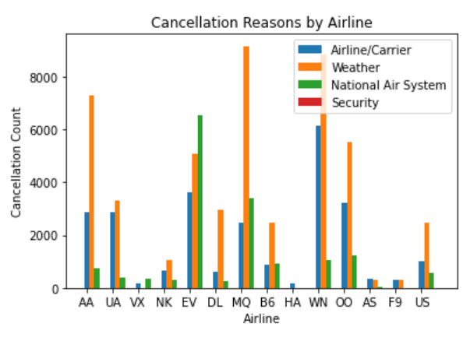
EDA- Continued
The bar graph show the cancellation reason per airline.
We see that weather is at the top of cancellations.
Figure9.Cancelation Reason of Every Airline

Slide 14
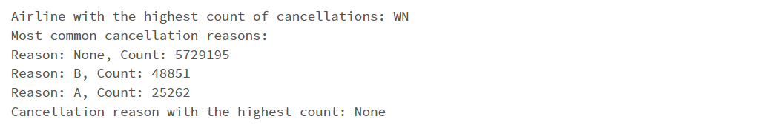
EDA-Continued
Figure10.Key Statistics About Cancelation Information
In the provided dataset, the airline with the highest cancellation count is WN (Southwest Airlines) The most common cancellation reasons across all airlines are "Unknown", "Weather" and "Airline/Currier".

Slide 15
Flight Delay Prediction
The Multilinear Regression Model
The dependent variable:
'DEPARTURE_DELAY'
The independent variables:
'DISTANCE'
'AIRLINE’ ,'ORIGIN_AIRPORT'
'AIR_SYSTEM_DELAY’,'SECURITY_DELAY'
'AIRLINE_DELAY’,'LATE_AIRCRAFT_DELAY'
'WEATHER_DELAY'
After comparing ARIMA and Multilinear Regression Model, we selected Multilinear Regression model because of a lower RMSE.
A regression model that estimates the relationship between a quantitative dependent variable and two or more independent variables using a straight line.

Slide 16
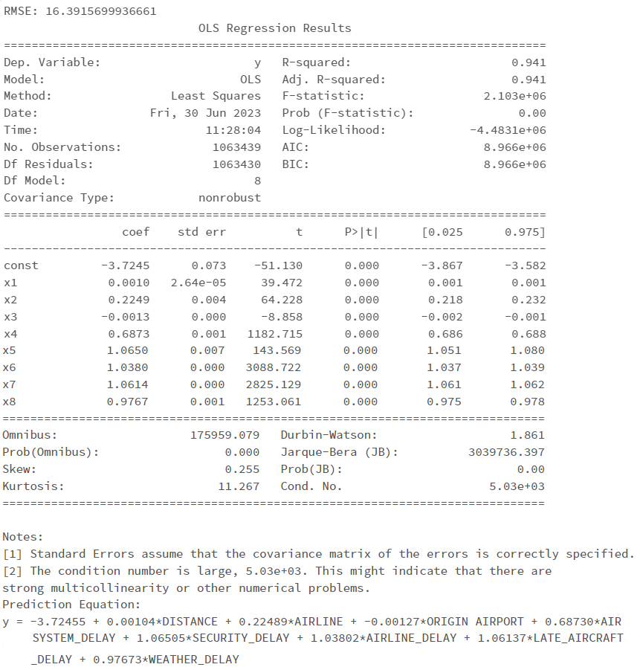
Flight Delay Prediction
Multilinear Regression Results
The p-values associated with each coefficient indicate the statistical significance of the variables.
The R-squared value is 0.941, suggesting that the model explains 94.1% of the dependent variable variance.
The regression model has an RMSE (Root Mean Squared Error) of 16.39, indicating the average prediction error of the model.
According to our Prediction Model and the Prediction Equation is
DEPARTURE_DELAY = -3.72455 + 0.00104*DISTANCE + 0.22489*AIRLINE + -0.00127*ORIGIN_AIRPORT + 0.68730*AIR_SYSTEM_DELAY + 1.06505*SECURITY_DELAY + 1.03802*AIRLINE_DELAY + 1.06137*LATE_AIRCRAFT_DELAY + 0.97673*WEATHER_DELAY
Figure11.Regression Model

Slide 17
Conclusion
The analysis of the 2015 flight delay and cancellation dataset revealed important insights into patterns and characteristics, contributing to improved air travel efficiency and reliability.
Departure delay analysis showed that flights tend to depart slightly later on average, but with significant variability. Understanding these patterns can help optimize departure schedules and operational efficiency.
Variation in delay distributions among airlines highlighted differences in performance. Some airlines excelled in minimizing long delays, indicating effective operational management.
Examining cancellation distributions provided insights into punctuality prioritization, with different airlines demonstrating varying levels of focus on punctuality.
Additionally, the analysis identified significant relationships between various factors
(DISTANCE, AIRLINE ,ORIGIN_AIRPORT ,AIR_SYSTEM_DELAY ,SECURITY_DELAY, AIRLINE_DELAY ,LATE_AIRCRAFT_DELAY, WEATHER_DELAY)
and the response variable (DEPARTURE_DELAY) with the regression model demonstrating good predictive capability.

Slide 18
Thank you!
Questions?

